Slide 1
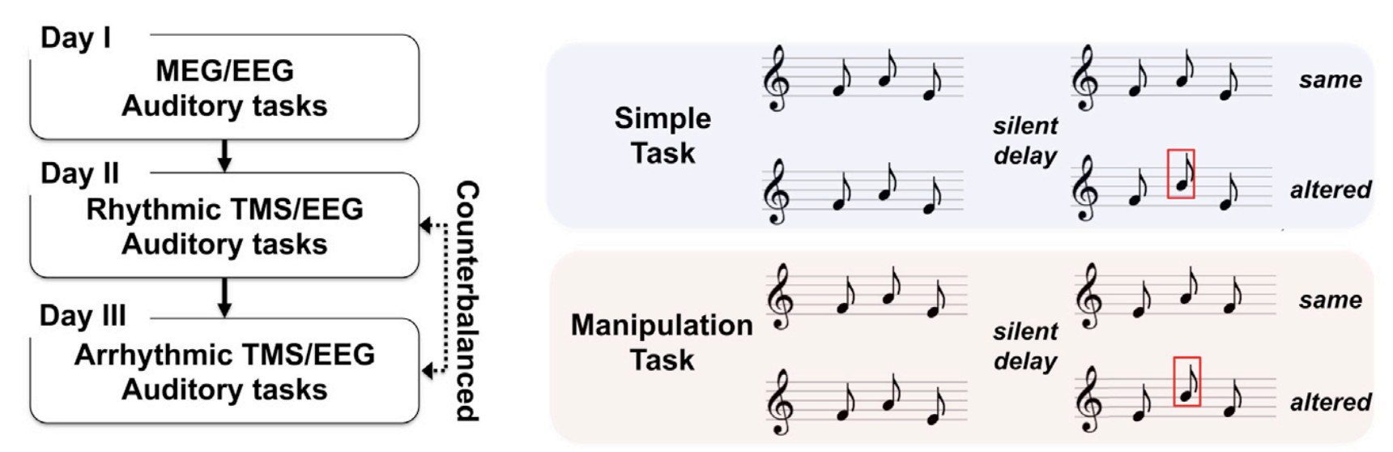
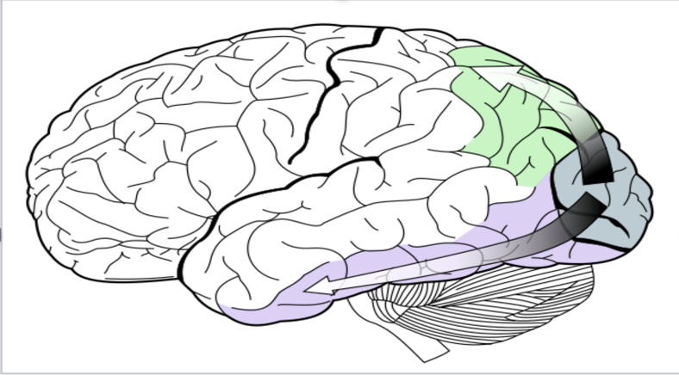
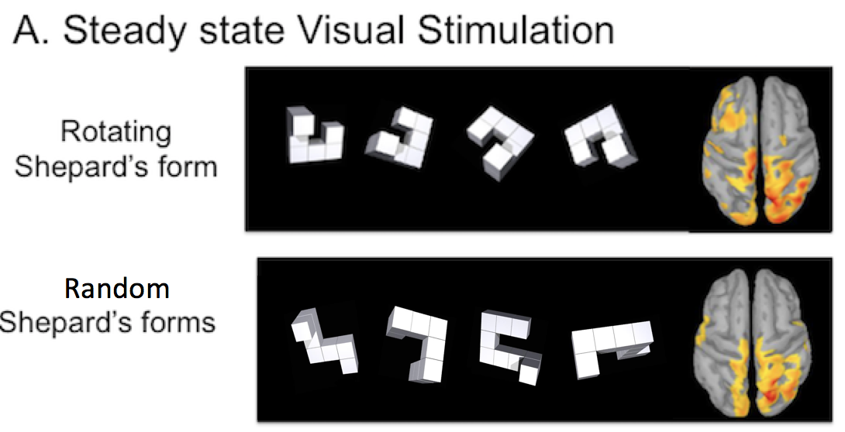
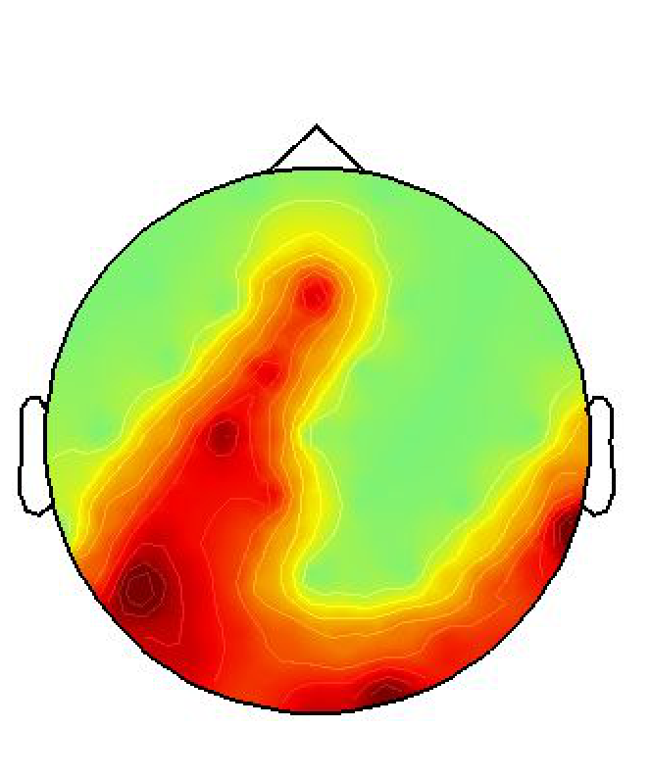
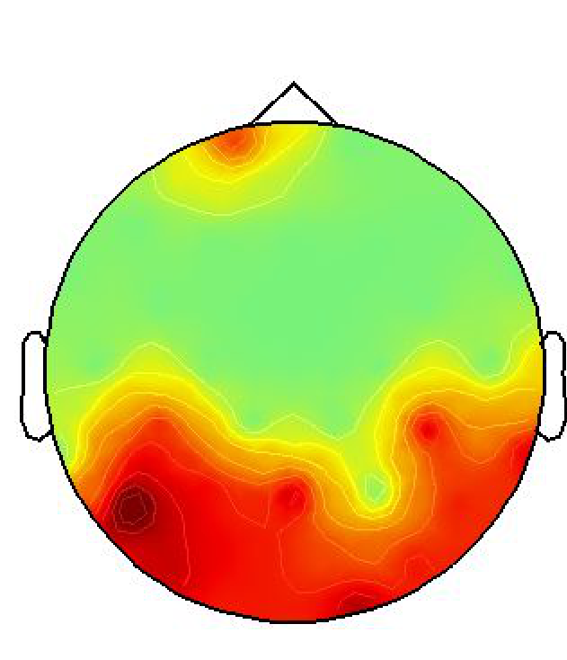
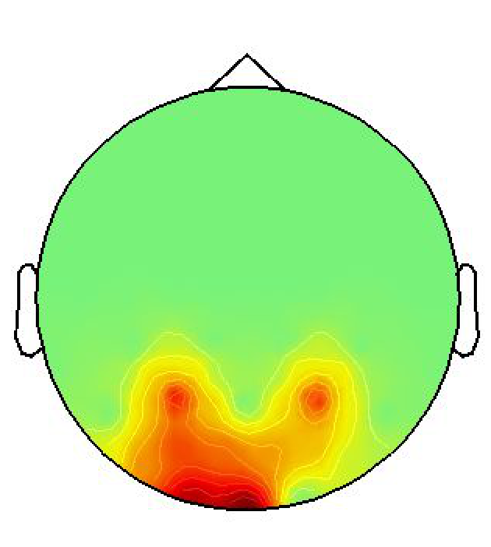
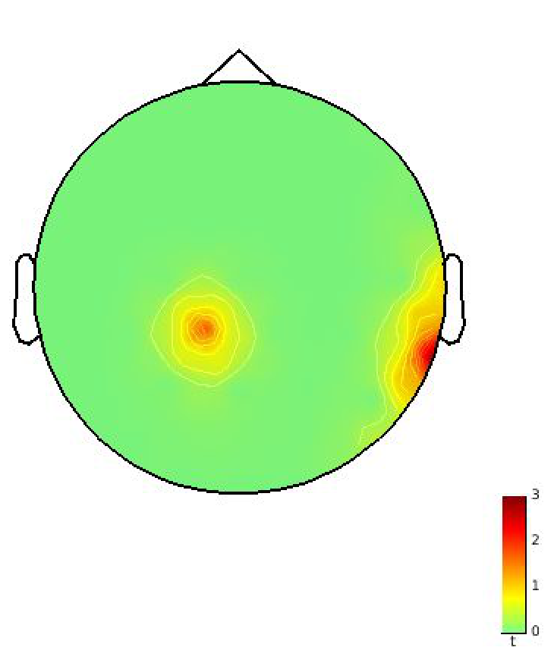
Analysis on longitudinal study of the “short-term” effects of brain stimulation with steady state visual stimulation on working memory performances in healthy volunteers
Rotate vs no stim
Random vs no stim
Rotate vs Random
Notes:
Memory is one of the primary reasons why many scientists are interested in researching on such a small portion in our body: brain.
My research was focusing on the auditorial working memory.
To learn about auditorial working memory changes, we study short term effects of brain stimulation with 4 seconds of steady state visual stiumlation.
Before we actually get into details, we really need to know, there are certain kinds of brain regions and brain streams that has been found closely related to our memory. So, knowing that facts from previous papers, we really want to focus on that green region: dorsal stream.
So, our goal is using 5 Hz steady state visual stimulation to train the dorsal stream and this dorsal stream will stimulate one of the brain regions (left intraprietal sulcus – point while talking) and look at how people improve the auditory memory performance before and after the train.
This study was extended from the previous study by one of the postdocs’ in the Sylvain’s lab was that Increased activity in the dorsal stream supports correct manipulation of auditory information in memory.
As you could see in the pictures on the bottom left corner, we could really see that there are slightly different brain regions are stimulated with different intensity based on whether its rotation or random.
And, it gets more clear when we get score by comparing rotating v.s. no stimulation and random v.s. no stimulation.
We came with the answer that a few seconds of rotating visual stimulation enhances brain oscillations in dorsal stream and thus, it can actually benefit the manipulation abilities in auditorial working memory performance than with no stimulation.
So, now we have a big lesson here! When we go take the final exam for music class, its better for us to stimulate our dorsal stream with some rotating steady state visual stimulations for a few sec before, and it will definitely help you prepare for the exam for sure.

